Slide 1
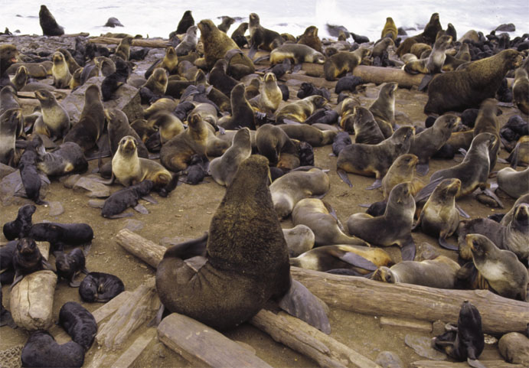
Chapter 52
Population Ecology
Chapter 52
Population Ecology

Slide 2
Population ecology is the study of populations in relation to the environment
  Includes environmental influences on population density and distribution, age structure, and variations in population size

Slide 3
Definition of a Population
A population is a group of individuals of the same species living in the same general area

Slide 4
Density and Dispersion
Density
  Is the number of individuals per unit area or volume
Dispersion
  Is the pattern of spacing among individuals within the boundaries of the population

Slide 5
Population density results from interplay of processes that add individuals and those that remove them from the population.
Immigration and birth add individuals whereas death and emigration remove individuals.

Slide 6
Patterns of Dispersion
Environmental and social factors
  Influence the spacing of individuals in a population

Slide 7
Patterns of dispersion: clumped
Clumped dispersion
  Individuals aggregate in patches
  Grouping may be result of the fact that multiple individuals can cooperate effectively (e.g. wolf pack to attack prey or antelope to avoid predators) or because of resource dispersion (e.g. mushrooms clumped on a rotting log)

Slide 8
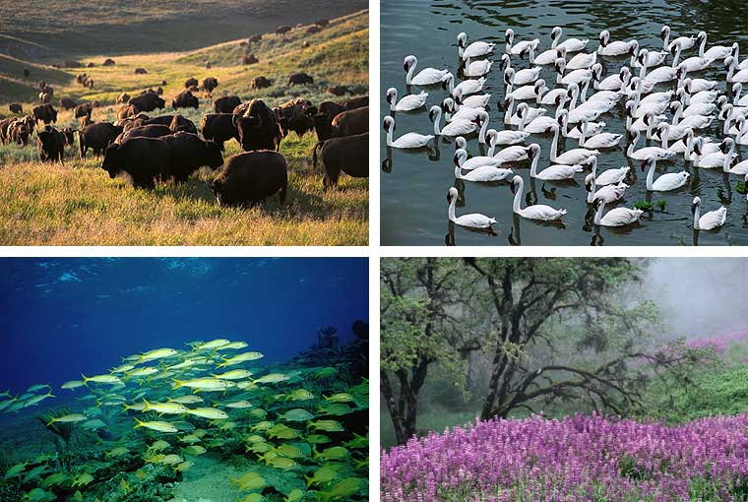
Clumped organisms

Slide 9
Pattern of dispersion: uniform
Uniform dispersion
  Individuals are evenly distributed
  Usually influenced by social interactions such as territoriality

Slide 10
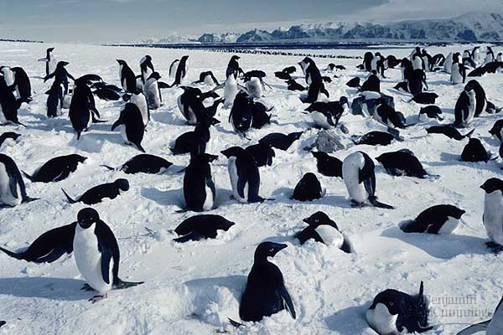
Uniformly distributed Penguins

Slide 11
Pattern of dispersion: random
Random dispersion: position of each individual is independent of other individuals (e.g. plants established by windblown seeds).
Uncommon pattern.

Slide 12
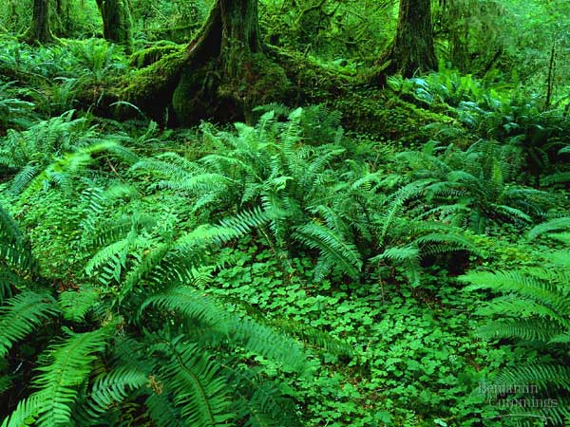
Randomly distributed ferns

Slide 13
Demography
Demography is the study of the vital statistics of a population and how they change over time
Death rates and birth rates
  Are of particular interest to demographers

Slide 14
Life Tables
Life table is an age-specific summary of the survival pattern of a population (first developed by the insurance industry)
Constructed by following the fate of a cohort (age-class of organisms) from birth to death.

Slide 15
Life table
Life table built by determining number of individuals that die in each age group and calculating the proportion of the cohort surviving from one age to the next.
Data for life tables hard to collect for wild populations.

Slide 16
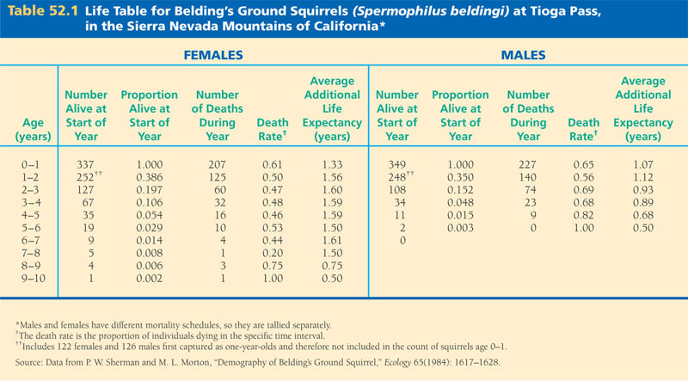

Slide 17
Life table for ground squirrels shows death rate for males is higher than that for females.
Also, notice that mortality rate is quite consistent from one year to the next.

Slide 18
Survivorship Curves
Data in a life table can be represented graphically by a survival curve.
Curve usually based on a standardized population of 1000 individuals and the X-axis scale is logarithmic.

Slide 19
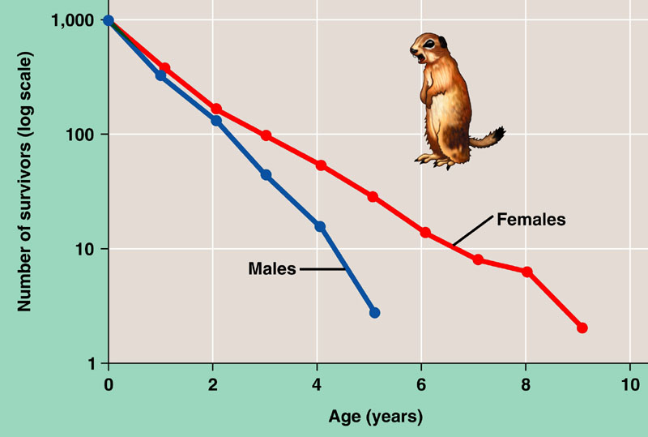

Slide 20
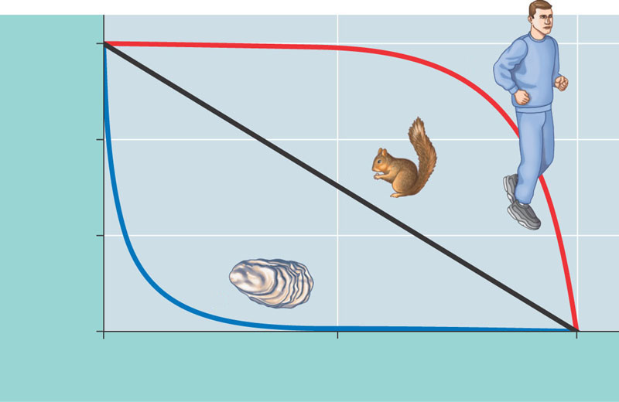
Survivorship curves can be classified into three general types
  Type I, Type II, and Type III
1,000
I
100
Number of survivors (log scale)
II
10
III
Figure 52.5
1
0
50
100
Percentage of maximum life span

Slide 21
Type I curve
Type I curve typical of animals that produce few young but care for them well (e.g. humans, elephants). Death rate low until late in life where rate increases sharply as a result of old age (wear and tear, accumulation of cellular damage, cancer).

Slide 22
Type II curve
Type II curve has fairly steady death rate throughout life (e.g. rodents).
Death is usually a result of chance processes over which the organism has little control (e.g. predation)

Slide 23
Type III curve
Type III curve typical of species that produce large numbers of young which receive little or no care (e.g. Oyster).
Survival of young is dependent on luck. Larvae released into sea have only a small chance of settling on a suitable substrate. Once settled however, prospects of survival are much better and a long life is possible.

Slide 24

Reproductive Rates
A reproductive table, or fertility schedule is an age-specific summary of the reproductive rates in a population.
Measured over life span of a cohort. The fertility schedule ignores males.

Slide 25
Reproductive Table
The table tallies the number of females produced by each age group.
Product of proportion of females of a given age that are breeding and the number of female offspring of those breeding females.

Slide 26
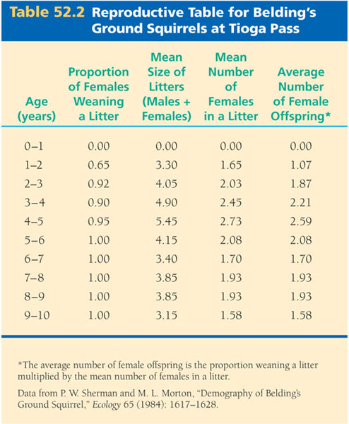
Table 52.2

Slide 27
Life History
Study of life histories focuses on explaining why organisms differ in their reproductive patterns.

Slide 28
Life History Traits
Life history traits are products of natural selection.
Life history traits are evolutionary outcomes reflected in the development, physiology, and behavior of an organism.
The current life history reflects the fact that organisms in the past that adopted this strategy left behind on average more surviving offspring than individuals who adopted other strategies.

Slide 29
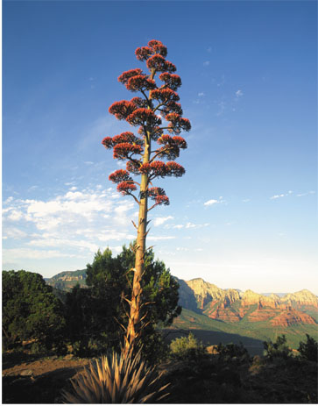
Life history diversity
Some species exhibit semelparity, or “big-bang” reproduction. These species reproduce once and die (bamboo, salmon, century plant).
Century Plant

Slide 30
Semelparous reproduction
Semelparous reproduction often an adaptation to erratic climatic conditions.
Suitable breeding conditions occur rarely and organisms devote all their resources to reproduction when conditions are good (e.g. century plant).

Slide 31
Iteroparous reproduction
Some species exhibit iteroparity, or repeated reproduction and produce offspring repeatedly over time.
E.g. humans, cats, birds.

Slide 32
Iteroparous reproduction
Iteroparous reproduction occurs when organisms have good prospects of reproducing in the future (i.e., they are long-lived).
Characteristic of larger organisms and those that experience more stable environmental conditions.

Slide 33
“Trade-offs” and Life Histories
Organisms have finite resources, which lead to trade-offs between survival and reproduction
For example kestrels whose broods were artificially enlarged had reduced overwinter survivorship. Conversely, birds whose broods were reduced had higher overwinter survivorship.

Slide 34
Quantity vs. Quality of offspring
Organisms face tradeoffs between the number and quality of young they can produce because they have only a limited quantity of resources to invest.
The choice is basically between a few large or many small offspring.

Slide 35
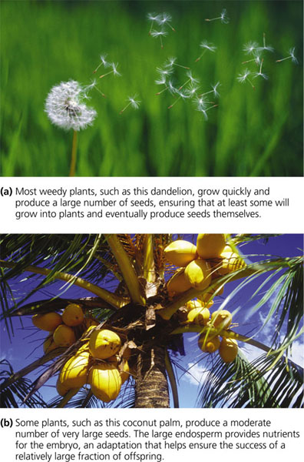

Slide 36
Population growth
Occurs when birth rate exceeds death rate (duh!)
Organisms have enormous potential to increase their populations if not constrained by mortality.
Any organism could swamp the planet in a short time if it reproduced without restraint.

Slide 37
Per Capita Rate of Increase
If immigration and emigration are ignored, a population’s growth rate (per capita increase) equals the per capita birth rate minus the per capita death rate

Slide 38
Equation for population growth is
ΔN/Δt = bN-dN
Where N = population size, b is per capita birth rate and d is per capita death rate. ΔN/Δt is change in population N over a small time period t.

Slide 39
The per capita rate of population increase is symbolized by r.
r = b-d.
r indicates whether a population is growing (r >0) or declining (r<0).

Slide 40
Ecologists express instantaneous population growth using calculus.
Zero population growth occurs when the birth rate equals the death rate r = 0.
The population growth equation can be expressed as
dN
=
rN
dt

Slide 41
Exponential population growth (EPG)
Describes population growth in an idealized, unlimited environment.
During EPG the rate of reproduction is at its maximum.

Slide 42
The equation for exponential population growth is
dN
=
r_{max}N
dt

Slide 43
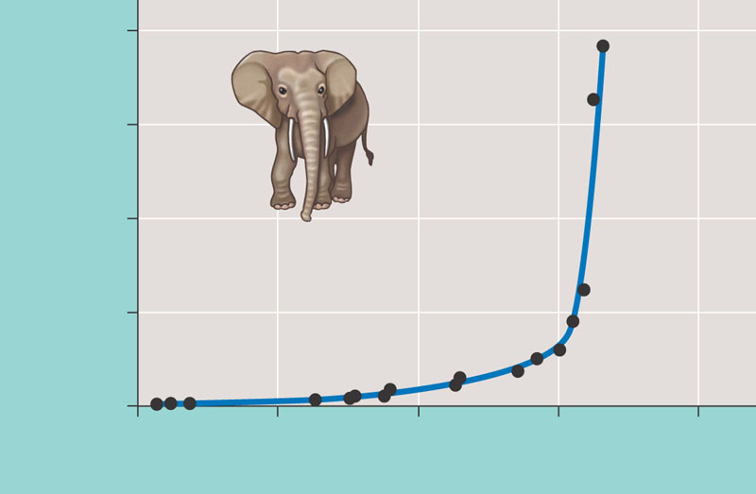
The J-shaped curve of exponential growth
  Is characteristic of some populations that are rebounding
8,000
6,000
Elephant population
4,000
2,000
0
1900
1920
1940
1960
1980
Figure 52.10
Year

Slide 44
Logistic Population Growth
Exponential growth cannot be sustained for
long in any population.
A more realistic population model limits
growth by incorporating carrying capacity.
Carrying capacity (K) is the maximum population size the environment can support

Slide 45
The Logistic Growth Model
In the logistic population growth model the per capita rate of increase declines as carrying capacity is approached.
We construct the logistic model by starting with the exponential model and adding an expression that reduces the per capita rate of increase as N increases

Slide 46
The logistic growth equation includes K, the carrying capacity (number of organisms environment can support)
dN
(K − N)
=
r_{max}
N
dt
K
As population size (N) increases, the equation ((K-N)/K)
becomes smaller which slows the population’s growth
rate.

Slide 47
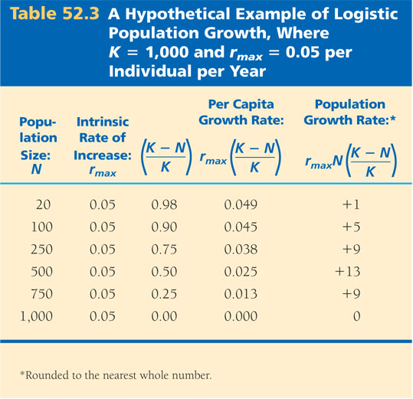

Slide 48
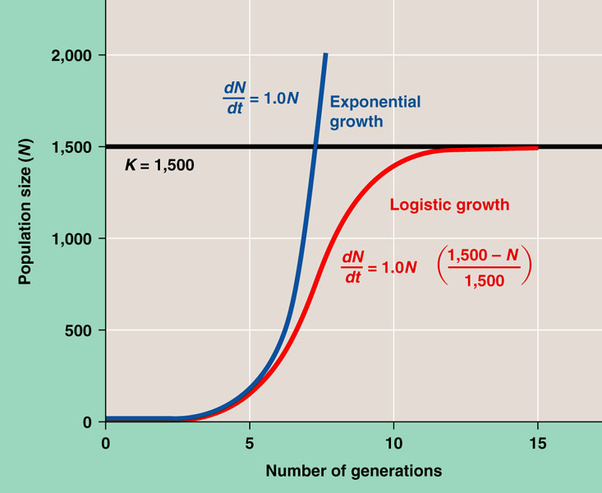
Logistic model produces a sigmoid (S-shaped) population
growth curve.

Slide 49
Logistic model predicts different per capita growth rates for populations at low and high density. At low density population growth rate driven primarily by r the rate at which offspring can be produced. At low density population grows rapidly.
At high population density population growth is much slower as density effects exert their effect.

Slide 50
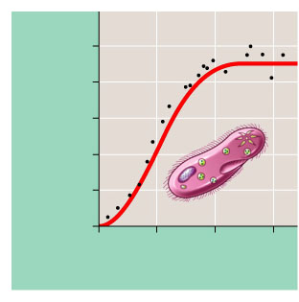
The Logistic Model and Real Populations
The growth of laboratory populations of paramecia fits an S-shaped curve
1,000
800
600
Number of Paramecium/ml
400
200
0
0
5
10
15
Time (days)
(a) A Paramecium population in the lab. The growth of Paramecium aurelia in small cultures (black dots) closely approximates logistic growth (red curve) if the experimenter maintains a constant environment.
Figure 52.13a

Slide 51
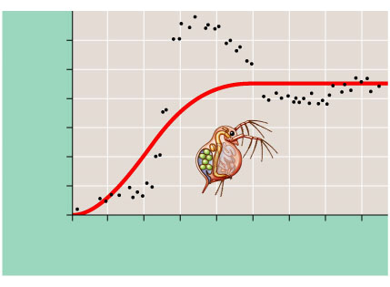
Some populations overshoot K before settling down to a relatively stable density
180
150
120
90
Number of Daphnia/50 ml
60
30
0
0
20
40
60
80
100
120
140
160
Time (days)
(b) A Daphnia population in the lab. The growth of a population of Daphnia in a small laboratory culture (black dots) does not correspond well to the logistic model (red curve). This population overshoots the carrying capacity of its artificial environment and then settles down to an approximately stable population size.
Figure 52.13b

Slide 52
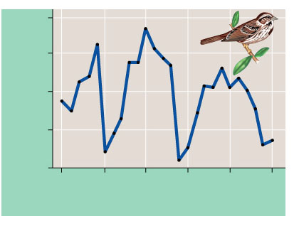
Some populations fluctuate greatly around K.
80
60
40
Number of females
20
0
_x001d_1975
_x001d_1980
_x001d_1985
_x001d_1990
_x001d_1995
_x001d_2000
Time (years)
(c) A song sparrow population in its natural habitat. The population of female song sparrows nesting on Mandarte Island, British Columbia, is periodically reduced by severe winter weather, and population growth is not well described by the logistic model.
Figure 52.13c

Slide 53
The Logistic Model and Life Histories
Life history traits favored by natural selection may vary with population density and environmental conditions.
At low density, per capita food supply is relatively high. Selection for reproducing quickly (e.g by producing many small young) should be favored.
At high density selection will favor adaptations that allow organisms to survive and reproduce with few resources. Expect lower birth rates.

Slide 54
K-selection, or density-dependent selection
  Selects for life history traits that are sensitive to population density
r-selection, or density-independent selection
  Selects for life history traits that maximize reproduction

Slide 55
The concepts of K-selection and r-selection have been criticized by ecologists as oversimplifications.
Most organisms exhibit intermediate traits or can adjust their behavior to different conditions.

Slide 56
Population regulation
Populations are regulated by a complex interaction of biotic and abiotic influences

Slide 57
Population Change and Population Density
In density-independent populations birth rate and death rate do not change with population density.
For example, in dune fescue grass environmental conditions kill a similar proportion of individuals regardless of density.

Slide 58
In contrast in density-dependent populations birth rates fall and death rates rise with population density.
Density-dependent population regulation much more common than density- independent

Slide 59
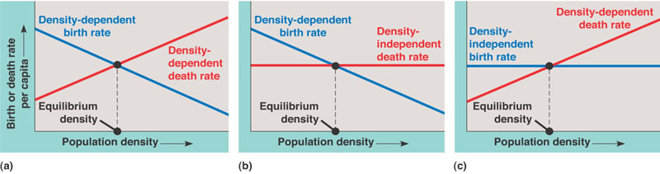
In density-dependent population either birth rate or
death rate or both may be density dependent.

